Slide 1
Guidance for Video/Audio in PowerPoints
1. Open the folder and copy all the files.
2. Paste the copied files into a new folder.
3. Open the PowerPoint file, enable editing and enter presentation mode (start the slide show).
Please note the embedded audio may not be compatible with early versions of PowerPoint.
You may wish to delete this slide before beginning the presentation.

Slide 3
Revisit and Review
Let’s practise reading some of this week’s focus words.
floor
dry
reply
by
door
sky
spy
sly
fly
try

Slide 4
Revisit and Review
Now, let’s write them on a whiteboard or paper.
sky
dry
sly
fly
try
by
reply
door
floor

Slide 5
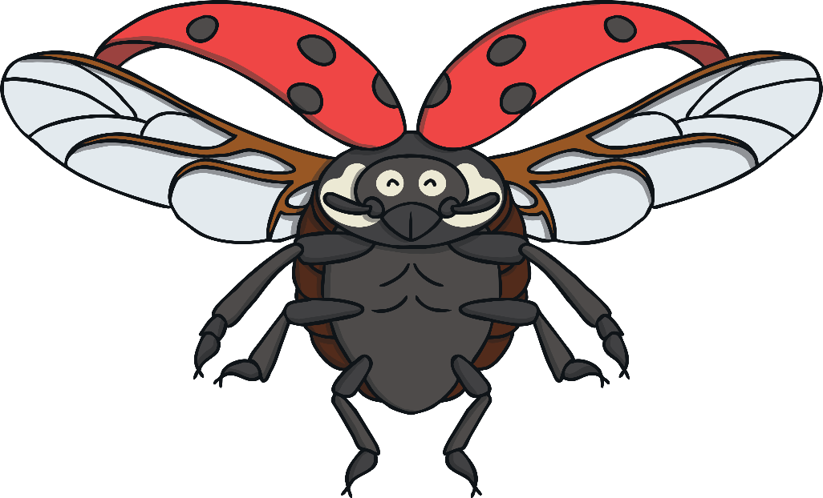
Teach
Today, we are learning to write a sentence containing y saying /igh/ words.
We are also learning that every sentence must begin with a capital letter and end with a full stop.

Slide 6
Teach
Kit, Sam and Ben were flying through the air on the back of a ladybird. “Woo hoo!” shrieked Sam. “This is fun!”
“I can see the whole garden!” shouted Kit.

Slide 7
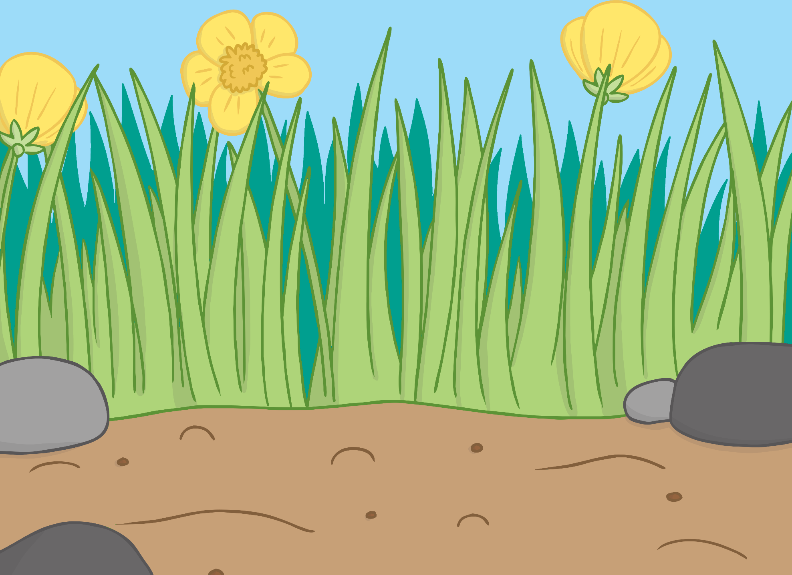
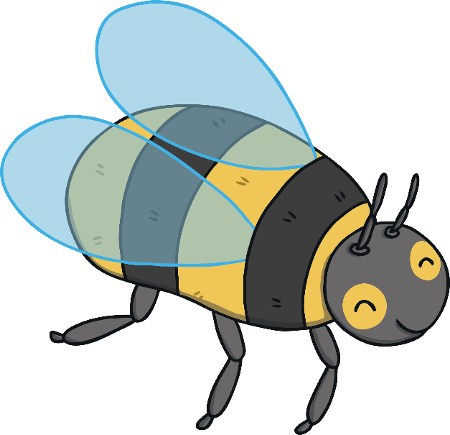
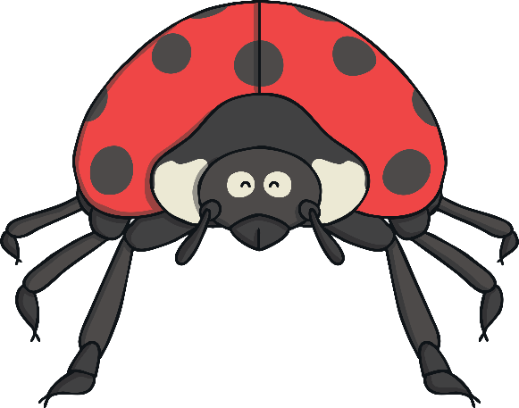
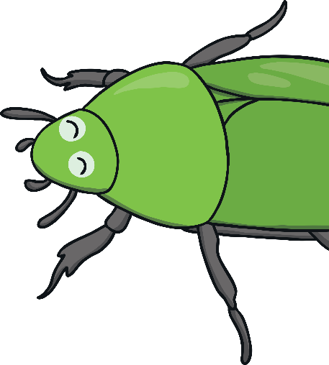
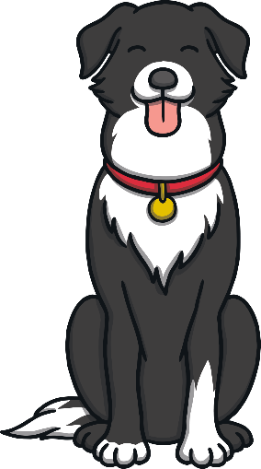
Teach
The ladybird landed in another part of the garden. There were many insects gathered there. “Welcome,” said the ladybird. “Come and meet all of my friends.”

Slide 8
Teach
?
?
X
What kind of minibeast is Lucy?
“Hello,” said Kit and Sam nervously.
“Don’t be afraid,” said the ladybird. “I’m Lucy and this is Billy, Betty and Belinda. We’re having a party!”

Slide 9
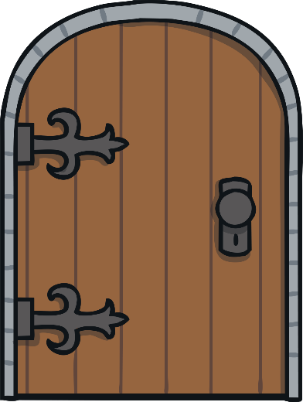
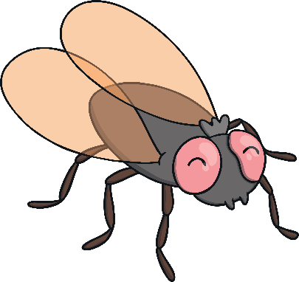
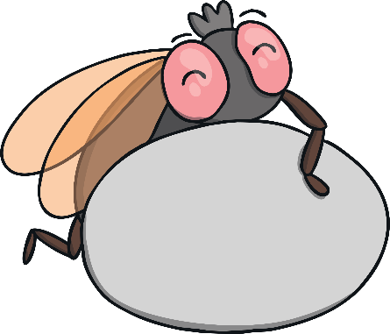
Teach
A sentence is a set of words which makes up a complete thought. It could be a statement, question, exclamation, or command.
T
the butterfly is on the floor
he
butterfly
is
on
the
floor
.
X
Remind children that every sentence must begin with a capital letter and end with a full stop.
Click me for Kit’s teaching tips!

Slide 10
Practise
Insect Party
Write a sentence using a y saying /igh/ word. Remember to use a capital letter and a full stop.
X
This is a great whiteboard activity which could be done individually or in pairs!
Click me for Kit’s teaching tips!

Slide 11
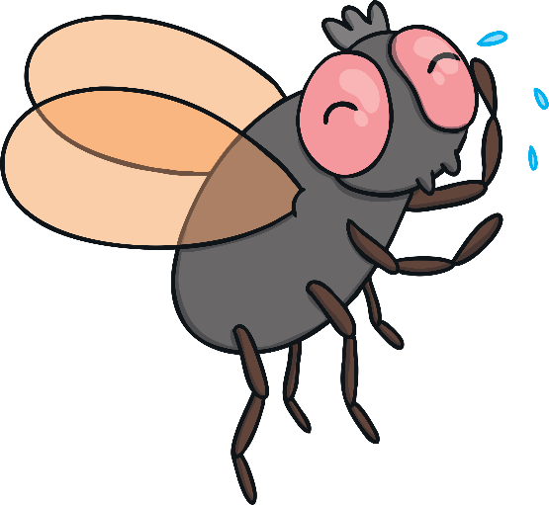
Practise

Slide 12
Apply
Sentence Scribers
What does the ladybird say to Kit, Sam and Ben? Write down the sentences. Remember to start each sentence with a capital letter and end with a full stop.
X
Observe if the children use and spell this week’s focus words or common exception words correctly in the sentences?
Click me for Kit’s teaching tips!

Slide 13
Apply
Come off the floor and fly with me.
Play
Show Sentence

Slide 14
Apply
Let us see what we can spy.
Play
Show Sentence

Slide 15
Apply
We might have to be sly.
Play
Show Sentence

Slide 16
Teach
As the party finished, they all collapsed on the grass. “I think it’s time for party food,” said Lucy. “Who’s hungry?”
“Me!” replied Kit and Sam.

Slide 17
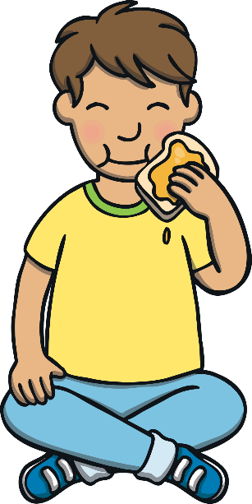
Teach
“Thanks for the honey, Betty,” said Kit. “It has been great to meet you all. I thought our minibeast adventure was scary at first but it has turned out to be really fun.”

Slide 18
Teach
Sam got out the magic map. “It’s time for us to go,” she said, “but we’ll be back to visit again – especially now we know that you live just at the end of our garden!

Slide 19
Today, we have learnt to write sentences with words containing…
y
saying /igh/
We have also learnt that every sentence must begin with a capital letter and end with a full stop.

