Slide 1
Lesson 6: Using a computer responsibly
Year 1 – Computing systems and networks – Technology around us
Notes:
Last updated: 03-06-21
Resources are updated regularly — the latest version is available at: ncce.io/tcc.
This resource is licensed under the Open Government Licence, version 3. For more information on this licence, see ncce.io/ogl.

Slide 2
Lesson 6: Using a computer responsibly
Objectives
To create rules for using technology responsibly
I can identify rules to keep us safe and healthy when we are using technology in and beyond the home
I can give examples of some of these rules
I can discuss how we benefit from these rules

Slide 3
Think, pair, share
Introduction
What rules are in place at your school?
Notes:
Ask the learners to think, pair, share, ‘What rules are already in place at your school?’. Depending on your school’s policy, you may wish to prompt or encourage relevant responses.
Note down the rules that the learners provide on a large piece of paper or flipchart. These will be used in Activity 1.
Note: These rules should be general school rules before moving to computing related rules.
Speech bubble: https://pixabay.com/vectors/cloud-thinking-thought-bubble-304979/

Slide 4
Why do we have these rules?
Activity 1
There are four main reasons that we have rules.
To stay safe
To make sure we are all happy
So that we can learn
To help us to be kind to each other
Notes:
Ask them to think, pair, share, ‘Why do you have rules?’. Capture the learners’ ideas on a flipchart or large piece of paper. Click to animate and relate the learners ideas to four key areas:
To stay safe
To make sure we are all happy
So that we can learn
To help us to be good people

Slide 5
Where do your rules fit on the grid?
Activity 1
To be safe
To stay happy
To learn
To be kind to each other
Notes:
Group learner into pairs. Provide each pair with A1 Resource – Rules grid. Ask the learners to match the rules you have agreed in the introduction to the key areas on the grid provided. Explain to the learners that there is no right or wrong answer for this activity.
Note: If learners require support with reading, this activity could be completed with the whole class or in smaller, targeted groups.
Hard hat: https://pixabay.com/vectors/safety-helmet-helmet-safe-work-150913/
Smile emoji: https://pixabay.com/vectors/smiley-happy-face-smile-lucky-559124/
Owl: https://pixabay.com/vectors/owl-bird-book-wise-nature-47526/
Holding hands: https://pixabay.com/vectors/circle-colorful-cooperation-1300241/

Slide 6
Computer technology
Activity 2
What rules would help you to use computer technology safely?
Notes:
Ask learners to think about rules which would help them use computers safely in school. Record their ideas on a large piece of paper or flipchart.
Note: An example set of rules is included on slide 7, which can be used or adapted to your setting.
PC: https://pixabay.com/vectors/computer-desktop-workstation-office-158675/
Tablet: https://pixabay.com/vectors/ipad-tablet-tablet-computer-147691/
Laptop: https://pixabay.com/vectors/laptop-notebook-mobile-computer-154091/

Slide 7
Rules for using computer technology
Activity 2
Hold your device carefully
Stop using your device when someone is talking to you
Take turns with your partner
Use only the apps you have been asked to used
Don’t share your passwords
Notes:
PC: https://pixabay.com/vectors/computer-desktop-workstation-office-158675/

Slide 8
Using technology safely
Activity 2
Create a poster for using technology safely both at home and in school.
Using technology safely
Notes:
Tell the learners that they will create a poster using the rules you have noted. Learners could be split into groups and given a rule each to create their rule posters.
PC: https://pixabay.com/vectors/computer-desktop-workstation-office-158675/

Slide 9
Technology
Plenary
Technology is something that has been made to help you.
Notes:
Explain that they have looked at different types of technology. Remind the learners that technology is something that has been made to help others.
Scissors: https://pixabay.com/vectors/cut-scissors-tool-1295044/
Pencil: https://pixabay.com/vectors/school-pencil-pen-write-sketch-153561/
Sharpener: https://pixabay.com/vectors/pencil-sharpener-sharpener-office-159427/
Laptop: https://pixabay.com/vectors/laptop-notebook-mobile-computer-154091/
PC: https://pixabay.com/vectors/computer-desktop-pc-workstation-1295529/
Phone: https://pixabay.com/vectors/iphone-cellphone-smartphone-mobile-37856/

Slide 10
Computer technology
Desktop computer
Laptop computer
Plenary
Screen
Base unit
Keyboard
Mouse / trackpad
Notes:
Explain that they have looked at different types of computer technology and the different parts of computers.
Desktop: https://pixabay.com/vectors/computer-desktop-workstation-office-158675/
Laptop: https://pixabay.com/vectors/laptop-notebook-mobile-computer-154091/

Slide 11
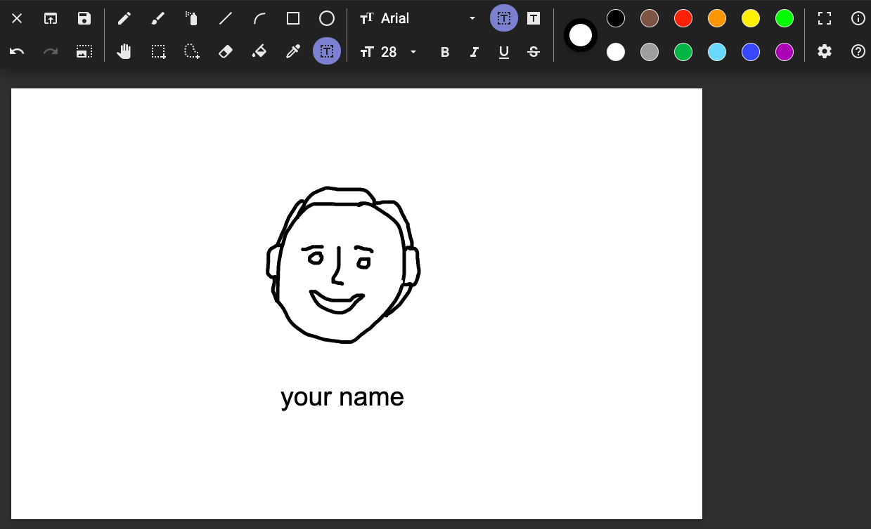
Keyboard and mice
Plenary
You used a keyboard and mouse to draw a picture and write words.
Notes:
Remind the learners they have used a mouse and keyboard to draw pictures and write words.
Wired mouse: https://pixabay.com/vectors/computer-mouse-computer-device-152249/
Wireless mouse: https://pixabay.com/vectors/computer-mouse-hardware-wheel-click-23266/
Two button trackpad: https://pixabay.com/vectors/mousepad-finger-mouse-pad-point-160223/
Wired keyboard: https://pixabay.com/vectors/computer-desktop-workstation-office-158675/
Screenshot: https://paintz.app

Slide 12
How confident are you? (from 1 to 3)
Assessment
I can identify rules to keep us safe and healthy when we are using technology in and beyond the home
I can give examples of some of these rules
I can discuss how we benefit from these rules
3 = very confident
2 = unsure
1 = not confident
Notes:
https://pixabay.com/vectors/thumb-up-hand-like-confirm-go-top-307176/

Slide 13
What you learned
Next time
In this lesson, you…
Learned how to use a computer safely and responsibly

